Slide 1
UCSD Embedded C Assignment 4
By
Hsuankai Chang
hsuankac@umich.edu

Slide 2
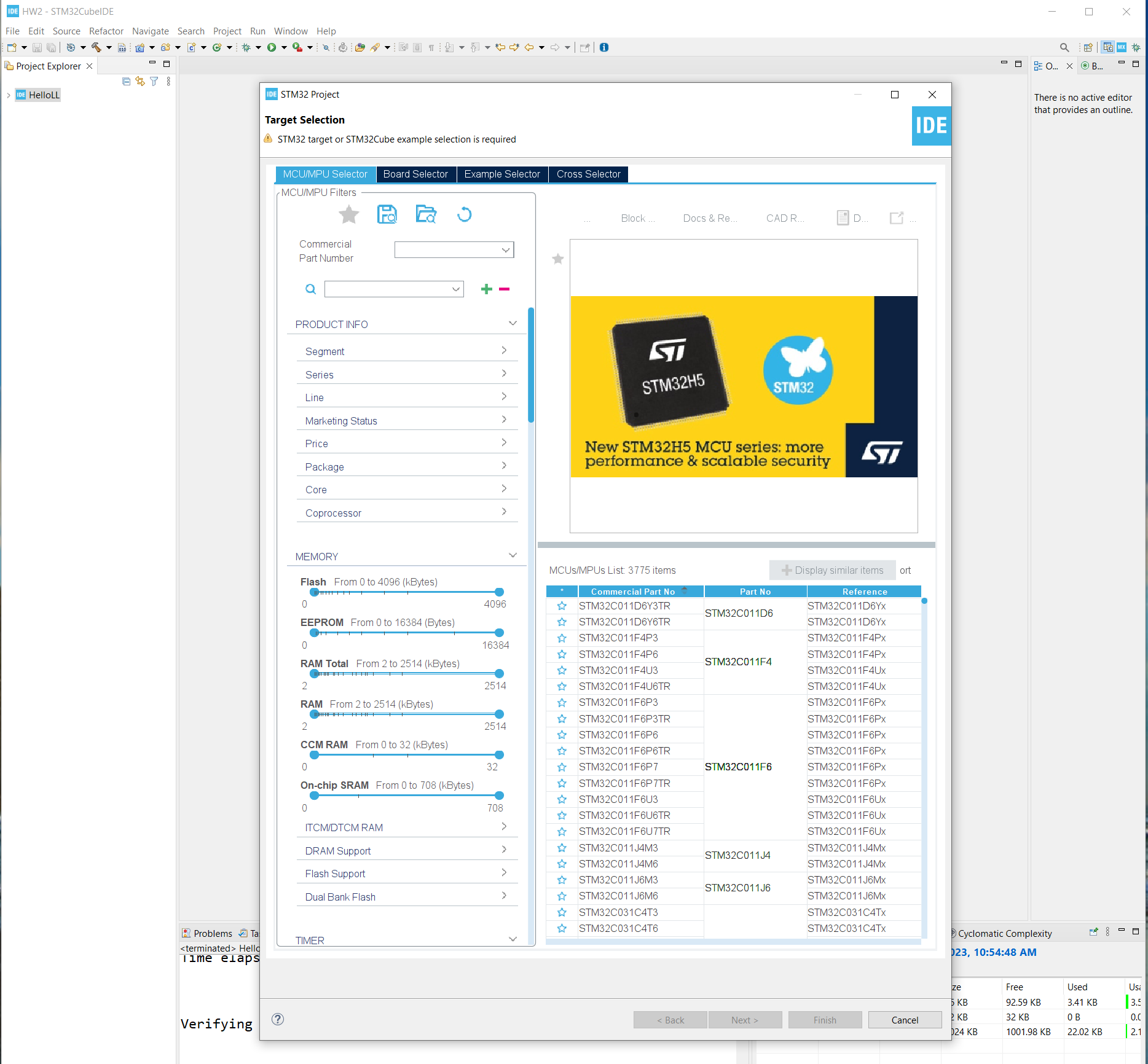
Step 1. Startup STM32CubeIDE and create new STM32 project

Slide 3
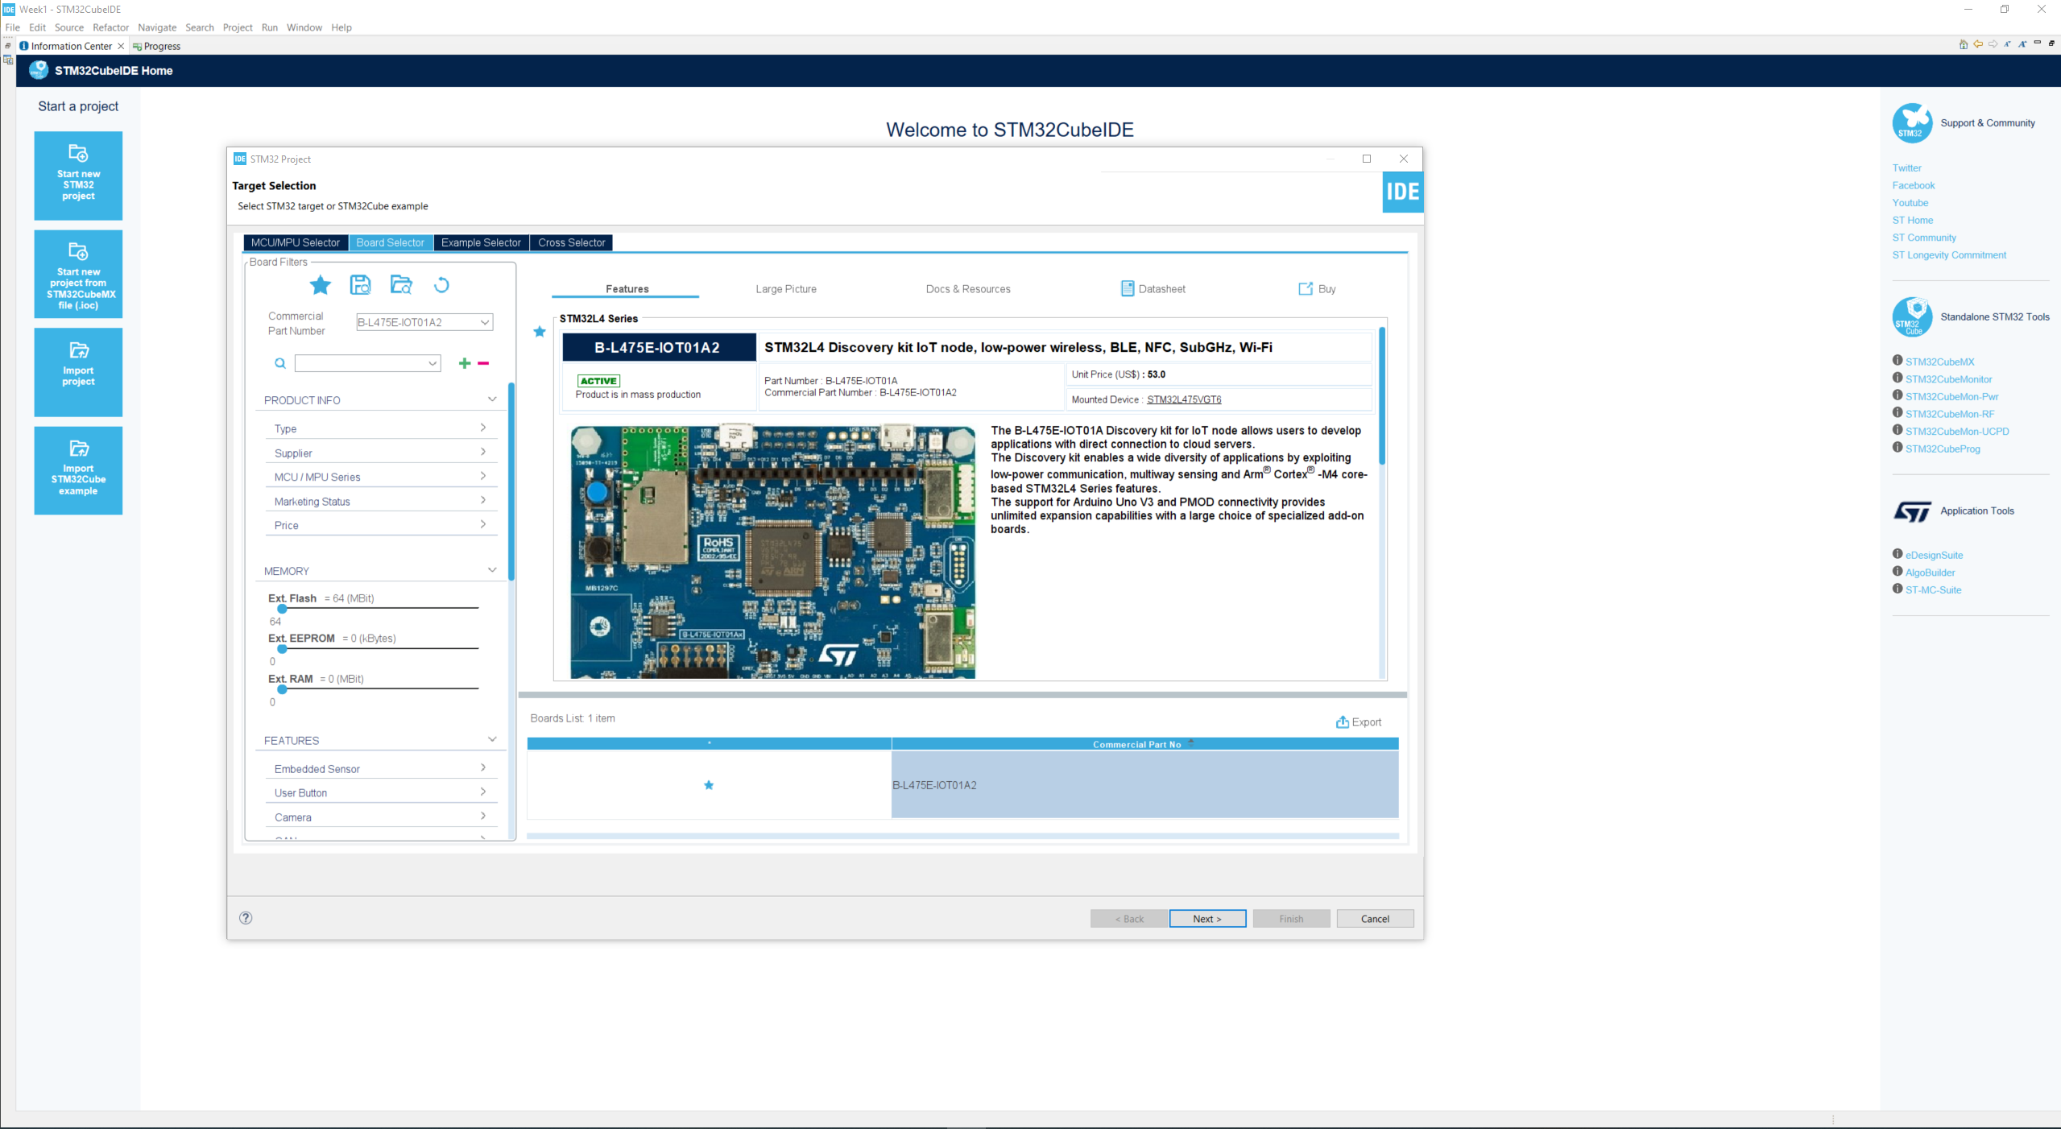
Step 2. Access board selector and type in the board you use, click Next

Slide 4
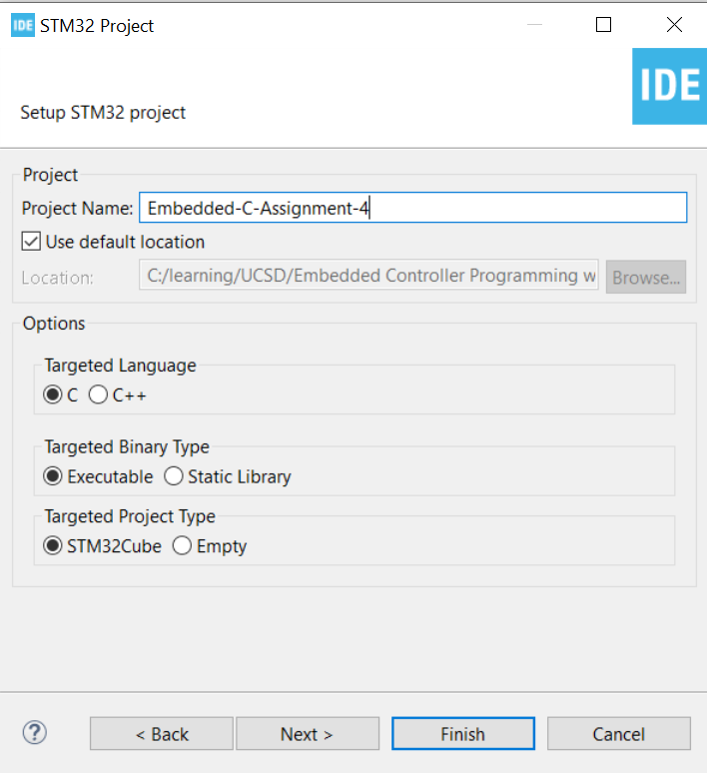
Step 3. Enter the project name then click Next

Slide 5
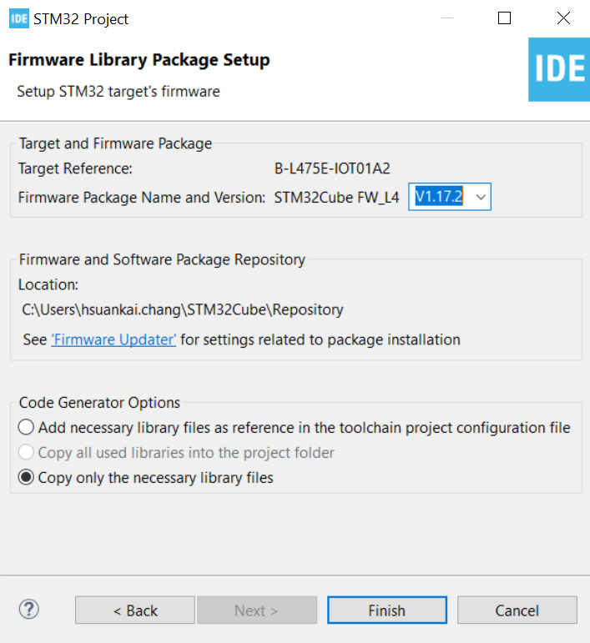
Step 4. See the firmware package name and version

Slide 6
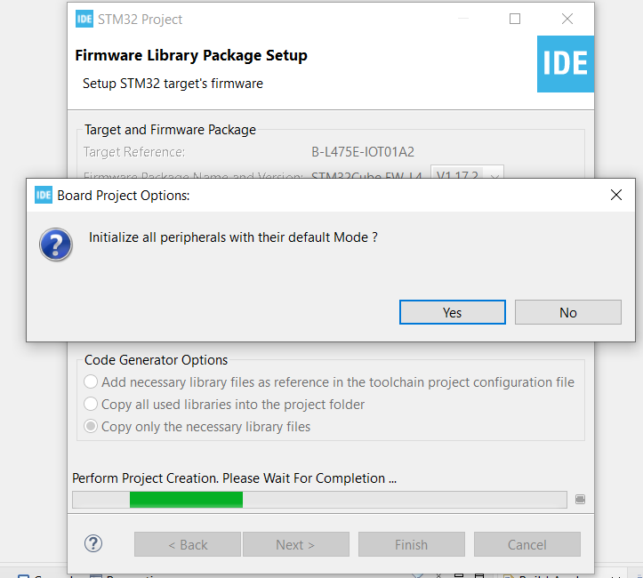
Step 5. Click yes to initialize all peripherals to default

Slide 7
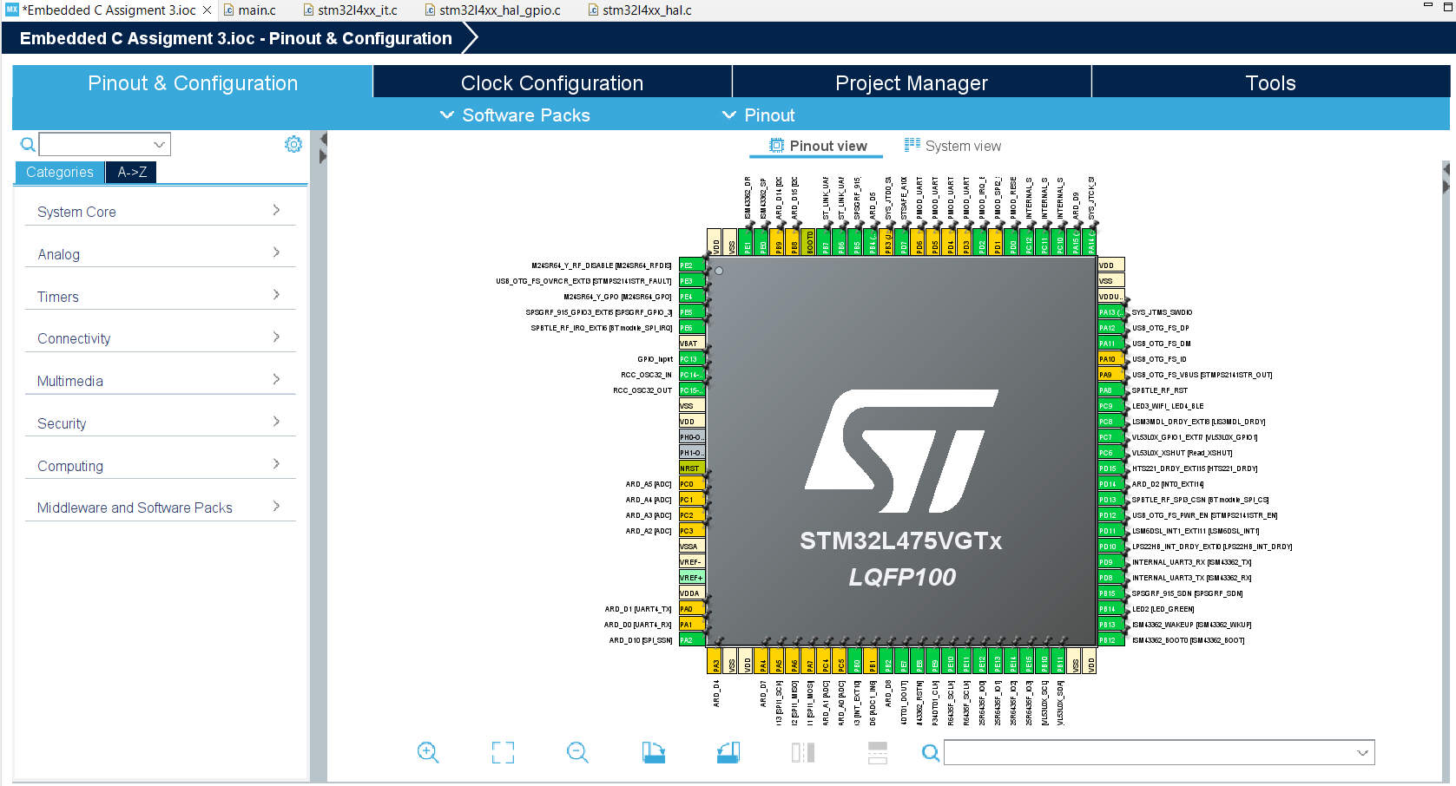
Step 6. When in .ioc file, click Pinout & Configurations, make sure BUTTON and LED2 are configured correctly

Slide 8
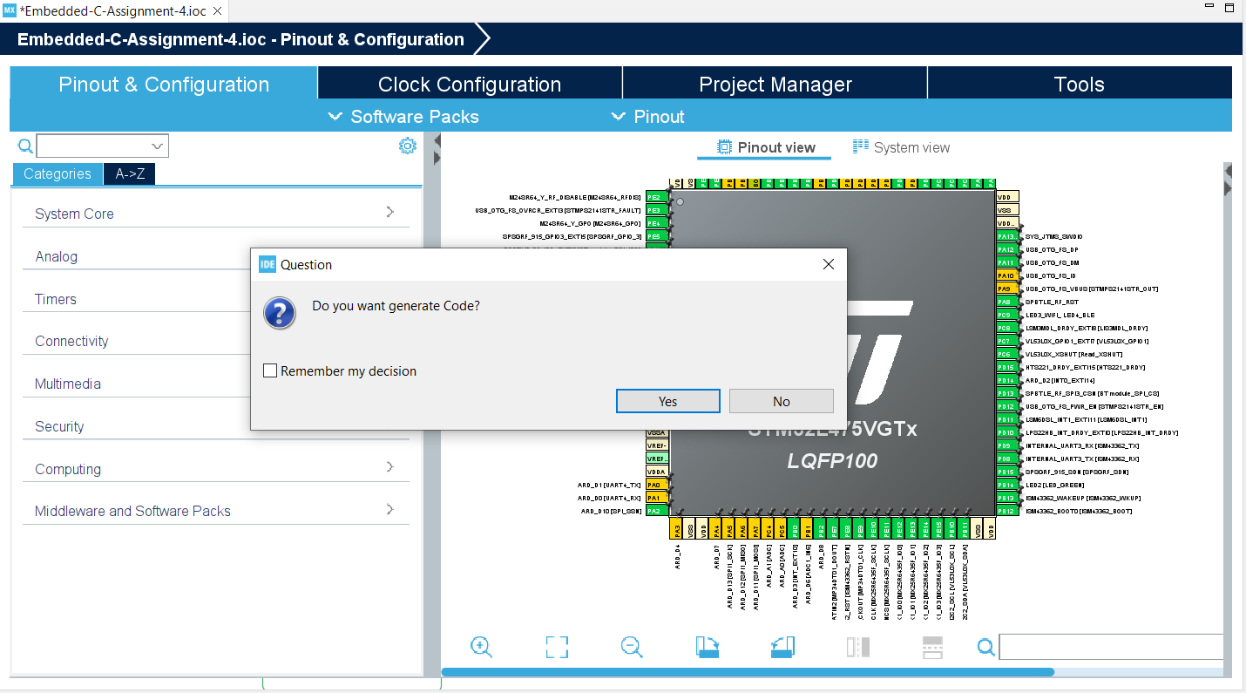
Step 7. Generate Code

Slide 9
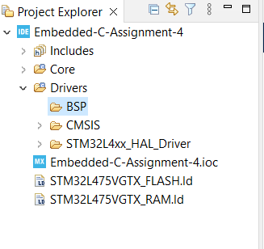
Step 8. Create new BSP folder under Drivers

Slide 10
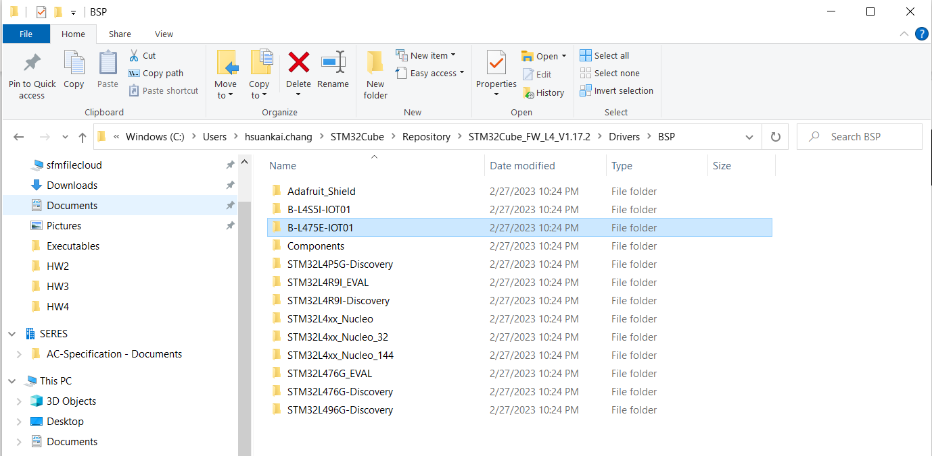
Step 9. Find the BSP code folder, B-L475E-IOT01 and Components folder that is included in Repository/../Drivers/BSP

Slide 11
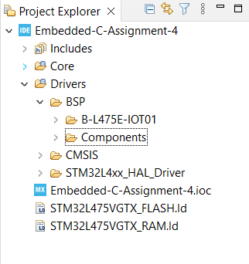
Step 10. Copy and paste it under the BSP folder

Slide 12
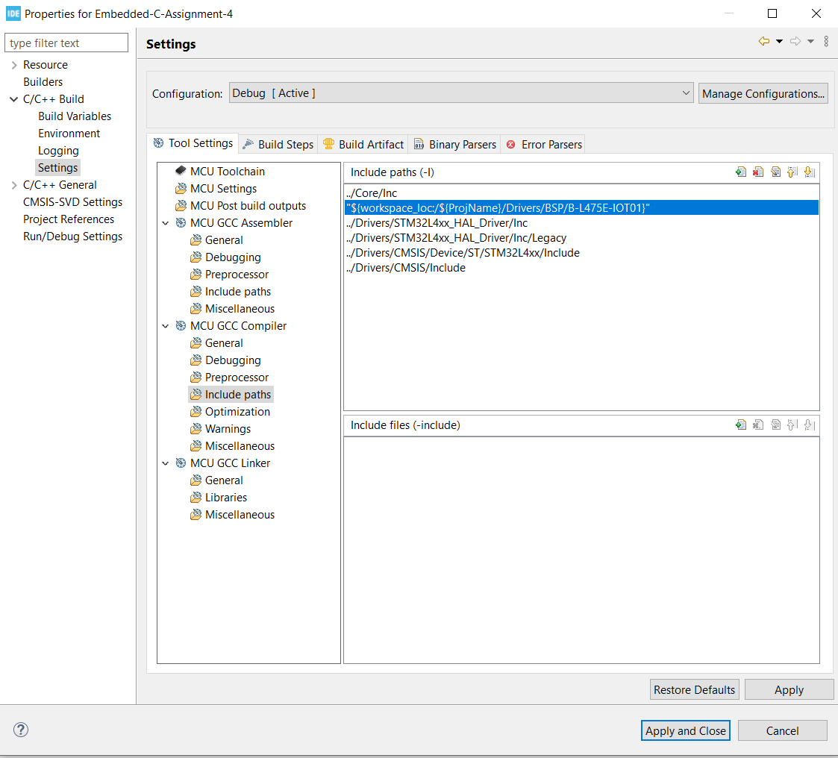
Step 11. Add BSP/B-L475E-IOT01 to include path

Slide 13
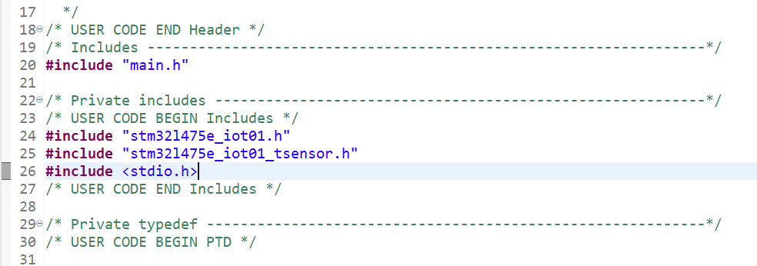
Step 12. Add BSP related code header files

Slide 14
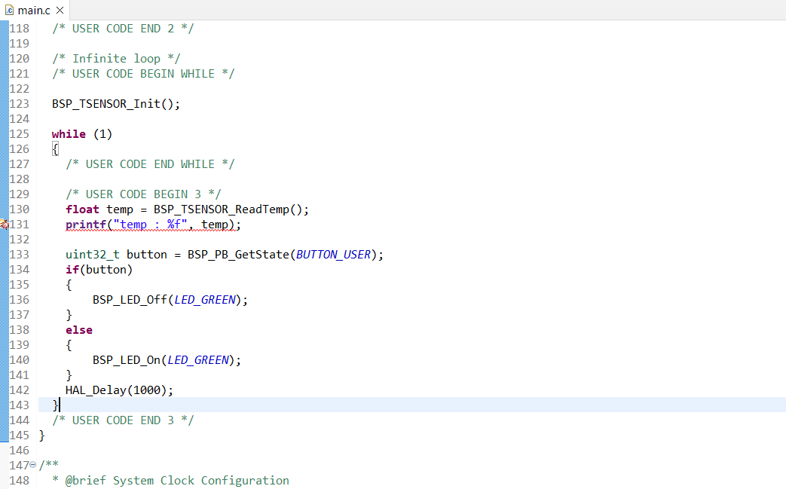
Step 13. Added the BSP code in main.c as below

Slide 15
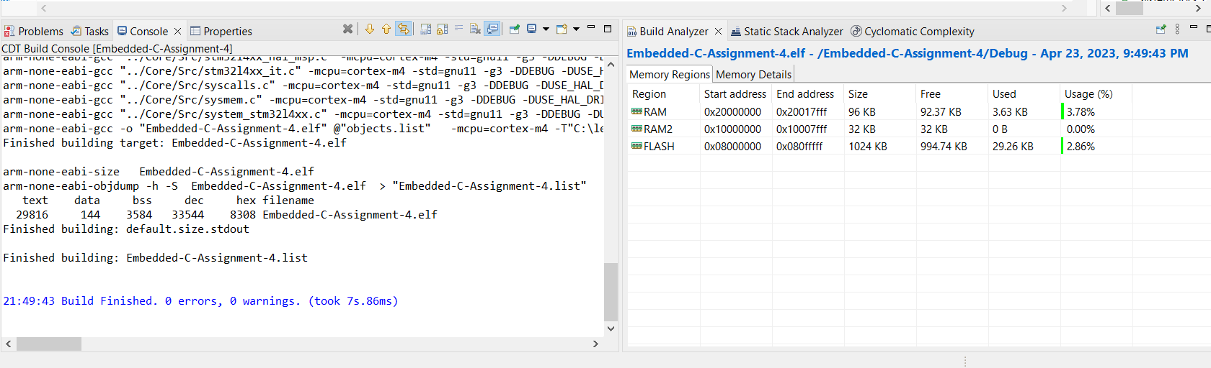
Step 14. See the result when finish building the project

Slide 16
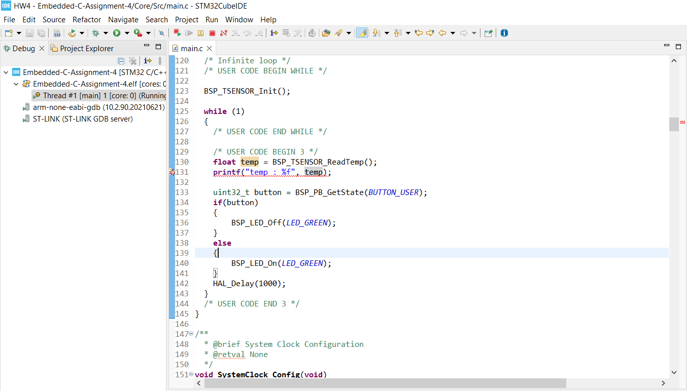
Step 15. Run in debug mode, confirm that LED toggles on/off when you press the button

